Slide 1

Support Vector Machine - Math
Presented by:
Elizer Ponio Jr.
Department of Computer Science
College of Computing and Information Technologies

Slide 2
Outline
Equation of the line and the General Form
Hard Margin SVM
Soft Margin SVM

Slide 3
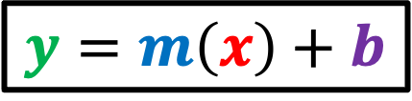
$$y=m\left(x\right)+b$$
Usually, we express the equation of a straight line like this, which is called the slope-intercept line form because the equation contains information about the slope and intercept of the line.
Snout Width
Size

Slide 4

$$y=m\left(x\right)+b$$
For example, this line is expressed as
$$y=0.5\left(x\right)+1$$
Snout Width
Since it intercepts the y-axis at 1 and has a slope of 0.5
Size

Slide 5

$$y=m\left(x\right)+b$$
If $m$ is zero and $b$ is 3, the line is expressed as
$$y=0\left(x\right)+3$$
$$y=3$$
Snout Width
Size

Slide 6
$$y=m\left(x\right)+b$$
How about this vertical line?
Snout Width
Size

Slide 7
$$y=m\left(x\right)+b$$
It turns out that that this form of equation cannot be used to describe a vertical line because the slope would be infinitely large
Snout Width
Size

Slide 8
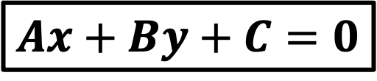
$$y=m\left(x\right)+b$$
This is one reason why we need to use the so-called “general form” of the equation for a straight line
Snout Width
$$Ax+By+C=0$$
Size

Slide 9
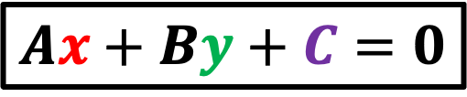
$$y=m\left(x\right)+b$$
$$Ax+By+C=0$$
Since vertical lines can be used to separate data points of two classes, the slope-intercept form to describe the line is not appropriate to use in SVM
Snout Width
Size

Slide 10
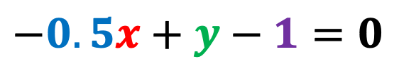
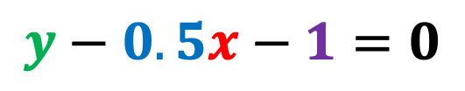
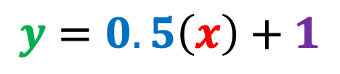
Suppose that we have the following line with a slope of 0.5 and intercept of one
$$y=0.5\left(x\right)+1$$
Snout Width
We will convert this equation to the general form
$$y−0.5x−1=0$$
$$−0.5x+y−1=0$$
Size

Slide 11
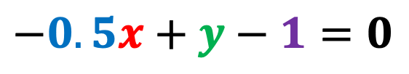
So that we have the following equation that describes the line in general form
$$−0.5x+y−1=0$$
Snout Width
Size

Slide 12
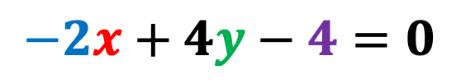
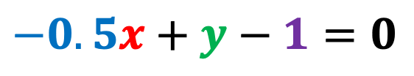
The coefficients are usually expressed as integers in this form
For example, if we multiply all terms by 4,
Snout Width
$$−0.5x+y−1=0$$
We get:
$$−2x+4y−4=0$$
Size

Slide 13
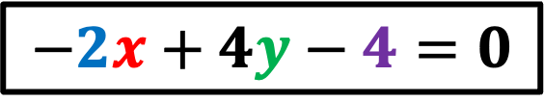
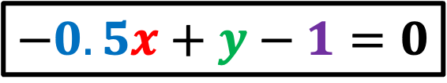
Both these equations describe the same line
$$−0.5x+y−1=0$$
Snout Width
$$−2x+4y−4=0$$
Size

Slide 14
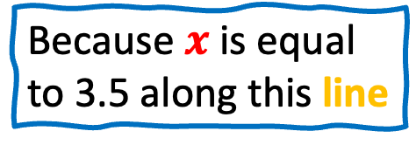

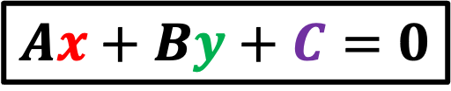
$$Ax+By+C=0$$
By using the general form, we can now describe the vertical line like this
Snout Width
$$x−3.5=0$$
Because $x$ is equal to 3.5 along this line
Size

Slide 15
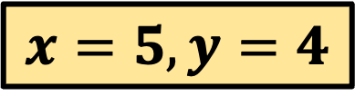
$$Ax+By+C=0$$
Another nice feature of the general form is that it can tell us which side of the line a data point is located on.
$$x=5,y=4$$
Snout Width
Size

Slide 16
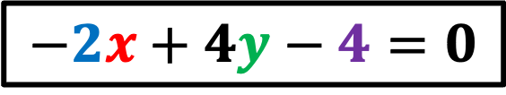
$$Ax+By+C=0$$
$$−2x+4y−4=0$$
$$x=5,y=4$$
Another nice feature of the general form is that it can tell us which side of the line a data point is located on.
Snout Width
Size

Slide 17



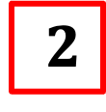
If we plugin the x and y coordinates of this data point in our equation,
$$x=5,y=4$$
Snout Width
$$−2x+4y−4=0$$
$$−2\left(5\right)+4\left(4\right)−4=0$$
$$−10+16−4=$$
$$2$$
Size

Slide 18

$$−10+16−4=2$$
We see that it results in a value greater than zero, which in case means that the data point is above the line
$$x=5,y=4$$
Snout Width
Size

Slide 19


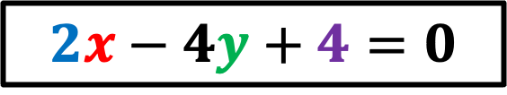
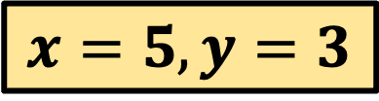
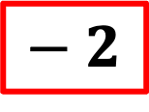
In comparison, this data point results in a negative value which tells us that the data point is below the line.
Snout Width
$$2x−4y+4=0$$
$$−2\left(5\right)+4\left(3\right)−4=0$$
$$x=5,y=3$$
$$−10+12−4=$$
$$− 2$$
Size

Slide 20
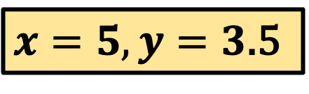


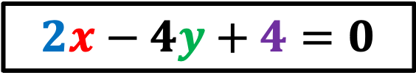

Note that any data point on the line will result in a value of zero
$$2x−4y+4=0$$
Snout Width
$$−2\left(5\right)+4\left(3.5\right)−4=0$$
$$−10+14−4=$$
$$0$$
$x=5,y=3$.5
Size

Slide 21
Outline
Equation of the line and the General Form
Hard Margin SVM
Soft Margin SVM

Slide 22
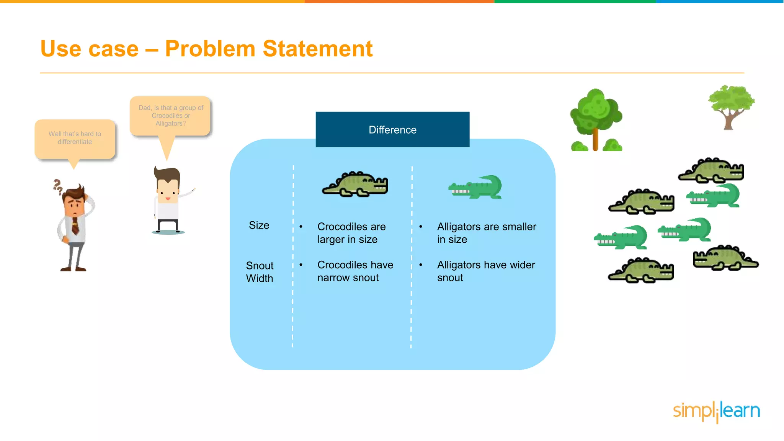
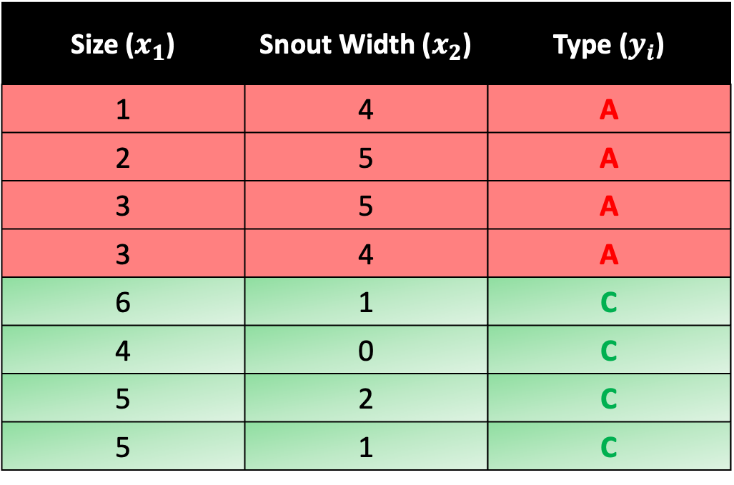
Size ($x_{1}$) | Snout Width ($x_{2}$) | Type ($y_{i}$)
1 | 4 | A
2 | 5 | A
3 | 5 | A
3 | 4 | A
6 | 1 | C
4 | 0 | C
5 | 2 | C
5 | 1 | C

Slide 23
Snout Width
Size

Slide 24

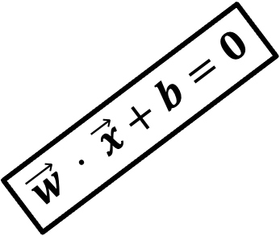
Assume we train an SVM on this dataset and find the optimal weight vector $\vec{w}$ to separate the classes.
Let’s say the resulting weight vector is:
$$\vec{w}= \left[\begin{aligned}−0.5 \\ 0.5\end{aligned}\right]$$
$$\vec{w} ⋅ \vec{x}+b=0$$
Snout Width
Size

Slide 25
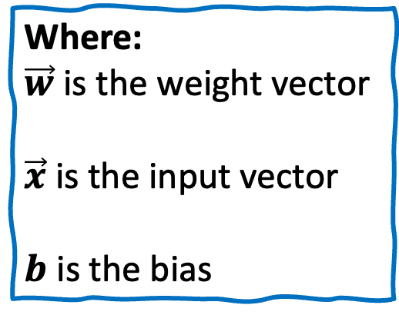
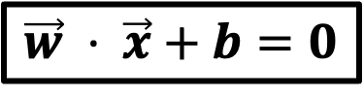
We can get the equation of our decision boundary using the form
$$\vec{w} ⋅ \vec{x}+b=0$$
$$\vec{w} ⋅ \vec{x}+b=0$$
Snout Width
Where:
$\vec{w}$ is the weight vector
$\vec{x}$ is the input vector
$b$ is the bias
Size

Slide 26
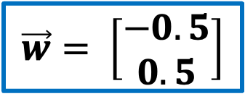



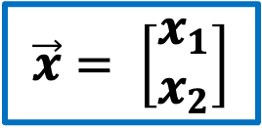
If we do the math..
$$\vec{w} ⋅ \vec{x}+b=0$$
$$\vec{w} ⋅ \vec{x}+b=0$$
$$\vec{w}= \left[\begin{aligned}−0.5 \\ 0.5\end{aligned}\right]$$
Snout Width
$$\vec{x}= \left[\begin{aligned}x_{1} \\ x_{2}\end{aligned}\right]$$
$$b=0.5$$
We get
$$−0.5x_{1}+0.5x_{2}+0.5=0$$
Size

Slide 27
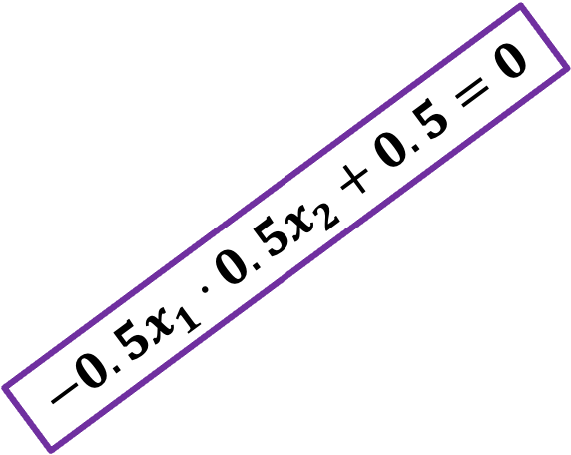

$$−0.5x_{1}+0.5x_{2}+0.5=0$$
This is the equation of the decision boundary or hyperplane
$$−0.5x_{1}⋅0.5x_{2}+0.5=0$$
Snout Width
Size

Slide 28
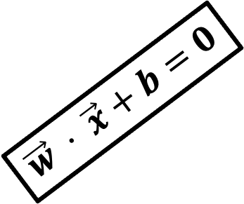
Next, we need to draw two parallel lines above and below the hyperplane.
It is like creating a highway or a street between our two classes.
$$\vec{w} ⋅ \vec{x}+b=0$$
Snout Width
Size

Slide 29
These two parallel lines defines the boundary of our ”highway” or ”street”
$$\vec{w} ⋅ \vec{x}+b=0$$
Snout Width
Size

Slide 30


Notice that our support vectors touches the boundary of our “street”
$$\vec{w} ⋅ \vec{x}+b=0$$
Snout Width
Support Vector
Support Vector
Size

Slide 31
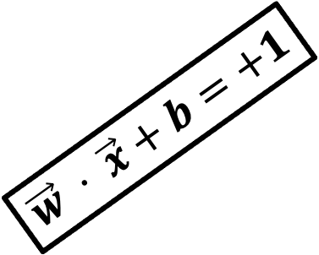
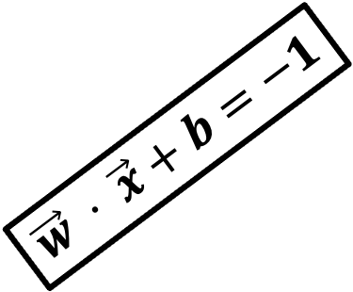
$$\vec{w} ⋅ \vec{x}+b=+1$$
These two parallel lines that define the boundary of our ”highway” are formed using these equations
$$\vec{w} ⋅ \vec{x}+b=0$$
Snout Width
Support Vector
$$\vec{w} ⋅ \vec{x}+b=−1$$
Support Vector
Size

Slide 32

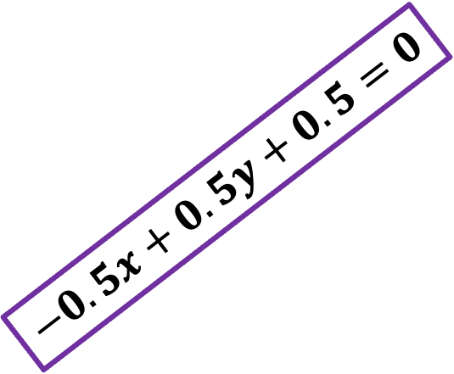
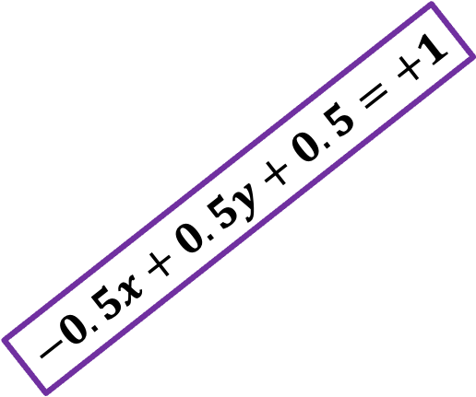
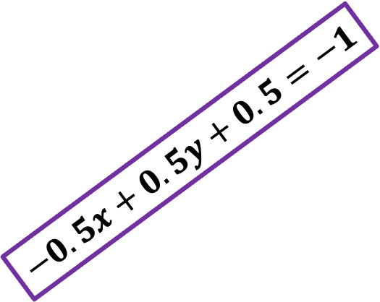


Thus, we will have the general form of all three lines
$$−0.5x+0.5y+0.5=+1$$
$$−0.5x+0.5y+0.5=0$$
Snout Width
$$−0.5x+0.5y+0.5=−1$$
$$−0.5x+0.5y+0.5=+1$$
$$−0.5x+0.5y+0.5=0$$
$$−0.5x+0.5y+0.5=−1$$
Size

Slide 33
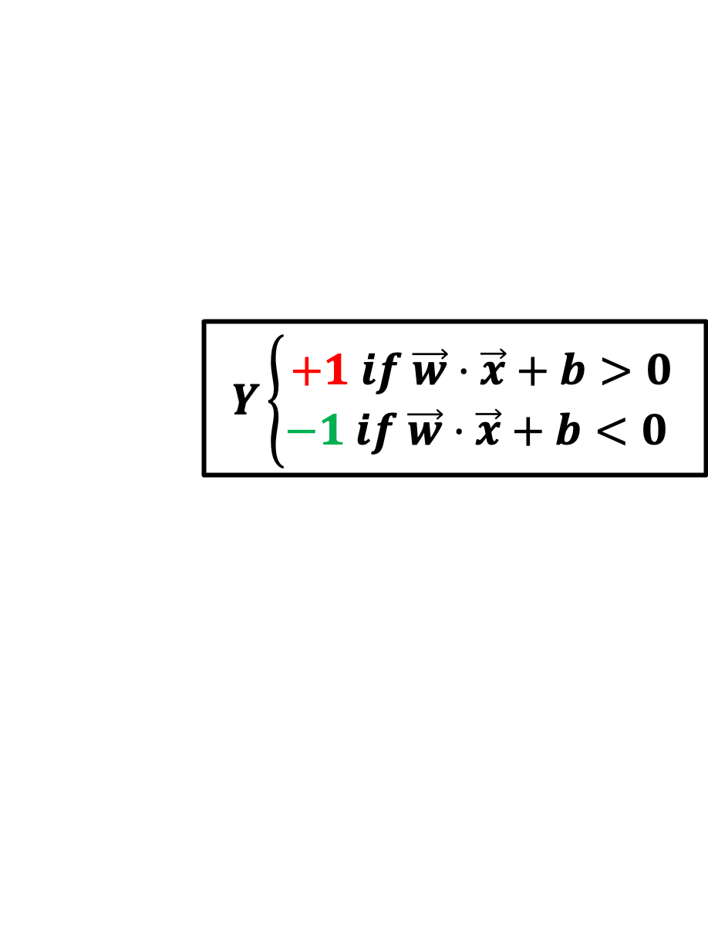
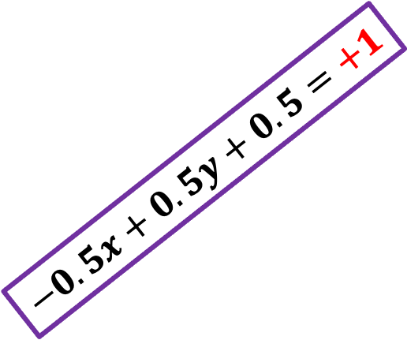
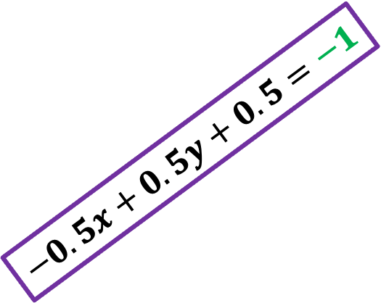
The classification of SVM is usually defined like this:
$$−0.5x+0.5y+0.5=+1$$
$$−0.5x+0.5y+0.5=0$$
Snout Width
$$−0.5x+0.5y+0.5=−1$$
$$Y\left\{\begin{aligned}+1 if \vec{w}⋅\vec{x}+b>0 \\ −1 if \vec{w}⋅\vec{x}+b<0 \end{aligned}\right.$$
Size

Slide 34

The classification of SVM is usually defined like this:
Snout Width
$$y_{i}\left\{\begin{aligned}+1 if \vec{w}⋅\vec{x}+b≥0 \\ −1 if \vec{w}⋅\vec{x}+b<0 \end{aligned}\right.$$
Size

Slide 35


$$y_{i}\left\{\begin{aligned}+1 if \vec{w}⋅\vec{x}+b≥0 \\ −1 if \vec{w}⋅\vec{x}+b<0 \end{aligned}\right.$$
We predict the class of a new sample to belong to the positive group if
$\vec{w}⋅\vec{x}+b$ is greater than or equal to 0
Snout Width
Size

Slide 36
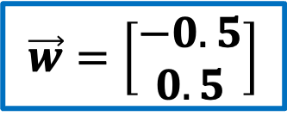



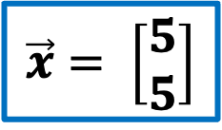
$$y_{i}\left\{\begin{aligned}+1 if \vec{w}⋅\vec{x}+b≥0 \\ −1 if \vec{w}⋅\vec{x}+b<0 \end{aligned}\right.$$
For example, if
Snout Width
$$\vec{w}=\left[\begin{aligned}−0.5 \\ 0.5\end{aligned}\right]$$
$$\vec{x}= \left[\begin{aligned}5 \\ 5\end{aligned}\right]$$
$$b=0.5$$
$$−0.5\left(5\right)+0.5\left(5\right)+0.5$$
$$=0.5$$
Size

Slide 37
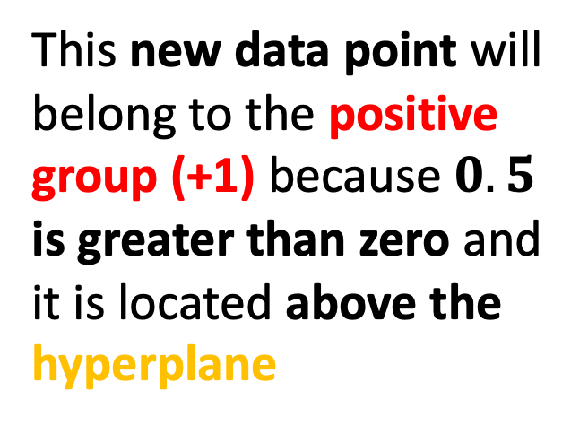
$$y_{i}\left\{\begin{aligned}+1 if \vec{w}⋅\vec{x}+b≥0 \\ −1 if \vec{w}⋅\vec{x}+b<0 \end{aligned}\right.$$
This new data point will belong to the positive group (+1) because $0.5$ is greater than zero and it is located above the hyperplane
Snout Width
Size

Slide 38

$$y_{i}\left\{\begin{aligned}+1 if \vec{w}⋅\vec{x}+b≥0 \\ −1 if \vec{w}⋅\vec{x}+b<0 \end{aligned}\right.$$
We predict the class of a new sample to belong to the negative group (+1) if $\vec{w}⋅\vec{x}+b$ is less than 0
Snout Width
Size

Slide 39


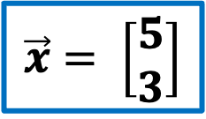
$$y_{i}\left\{\begin{aligned}+1 if \vec{w}⋅\vec{x}+b≥0 \\ −1 if \vec{w}⋅\vec{x}+b<0 \end{aligned}\right.$$
For example, if
Snout Width
$$\vec{w}=\left[\begin{aligned}−0.5 \\ 0.5\end{aligned}\right]$$
$$\vec{x}= \left[\begin{aligned}5 \\ 3\end{aligned}\right]$$
$$b=0.5$$
$$−0.5\left(5\right)+0.5\left(3\right)+0.5$$
$$=−0.5$$
Size

Slide 40

$$y_{i}\left\{\begin{aligned}+1 if \vec{w}⋅\vec{x}+b≥0 \\ −1 if \vec{w}⋅\vec{x}+b<0 \end{aligned}\right.$$
This new data point will belong to the negative group (-1) because $−0.5$ is less than zero and it is located below the hyperplane
Snout Width
Size

Slide 41

We can calculate the distance between two parallel lines with this equation
Snout Width
$$d= \frac{|c_{2}−c_{1}|}{\sqrt{A^{2}+B^{2}}}$$
Size

Slide 42






$$y=x−3$$
$$y−x=−3$$
$$−x+y=−3$$
Snout Width
$$−x+y+3=−3+3$$
$$−x+y+3=0$$
$$x−y+3=0$$
Size

Slide 43






$$y=x+1$$
$$y−x=1$$
$$−x+y=1$$
Snout Width
$$−x+y−1=1−1$$
$$−x+y−1=0$$
$$x−y+1=0$$
Size

Slide 44
Hard Margin
When the data is linearly separable, and we do not want to have any misclassifications, we use SVM with a hard margin.
Snout Width
Size

Slide 45
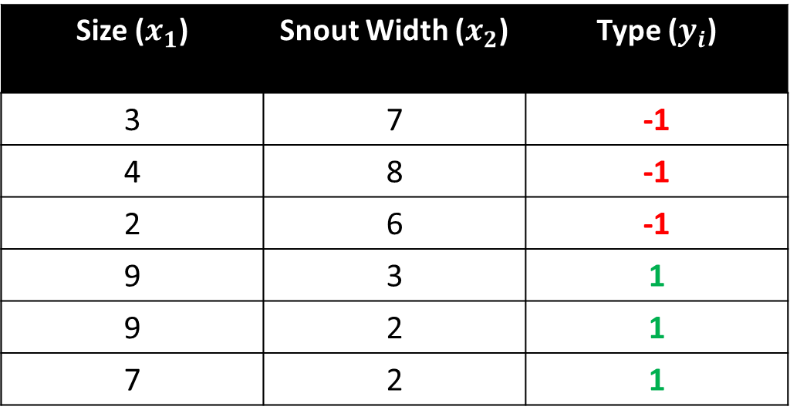
Crocodile and Alligator Example
Size ($x_{1}$) | Snout Width ($x_{2}$) | Type ($y_{i}$)
3 | 7 | -1
4 | 8 | -1
2 | 6 | -1
9 | 3 | 1
9 | 2 | 1
7 | 2 | 1

Slide 46
Snout Width
Size

Slide 47
-1
Snout Width
+1
Size

Slide 48



$\vec{w }$⋅ $\vec{x }$ - b = -1
Snout Width
$\vec{w }$⋅ $\vec{x }$ - b = +1
$\vec{w }$⋅ $\vec{x }$ - b = 0
Size

Slide 49


$\vec{w }$⋅ $\vec{x }$ - b = -1
Snout Width
$\vec{w }$⋅ $\vec{x }$ - b = +1
$\vec{w }$⋅ $\vec{x }$ - b = 0
$\vec{w_{1}}$ $\vec{x_{1}}$ + … + $\vec{w_{p}}$ $\vec{x_{p}}$ - b = 0
$$Hyperplane$$
Size

Slide 50

$$\vec{w }$$
Snout Width
Size

Slide 51

$$\vec{w }$$
Snout Width
$$margin size= \frac{2}{\left\|\vec{w }\right\|}$$
Size

Slide 52



$$\vec{w }$$
Snout Width
$$margin size= \frac{2}{\left\|\vec{w }\right\|}$$
$$We need to maximize the margin size.$$
$$in order to do this, we need to minimize \left\|\vec{w }\right\|$$
Size

Slide 53

$$\vec{w }$$
Snout Width
$$margin size= \frac{2}{\left\|\vec{w }\right\|}$$
Constraints:
$$\vec{w }\text{⋅ }\vec{x }\text{ − }\text{b}\text{ ≥ +1, }{if y}_{i}\text{ = }\text{+1}$$
$$\vec{w }\text{⋅ }\vec{x }\text{ − }\text{b}\text{ ≤ −1, }if y_{i}\text{ = }\text{−1}$$
Size

Slide 54

Hard Margin SVM Equation
$$\vec{w }\text{⋅ }\vec{x }\text{ − }\text{b}\text{ ≥ +1, }{if y}_{i}\text{ = }\text{+1}$$
$$\vec{w }\text{⋅ }\vec{x }\text{ − }\text{b}\text{ ≤ −1, }if y_{i}\text{ = }\text{−1}$$
These constraints state that each data point must lie on the correct side of the margin. These two conditions can be rewritten in a compact form
$$y_{i}\text{(}\vec{w}\text{ ⋅ } \vec{x_{i}}\text{ − }\text{b}\text{)} \text{≥ +1}$$

Slide 55


Hard Margin SVM Equation
$pick a w,b such that \left\|w\right\| is minimized$ while obeying the constraint
$$y_{i}\text{(}\vec{w}\text{ ⋅ } \vec{x_{i}}\text{ − }\text{b}\text{)} \text{≥ +1}$$
$$for all i=1, …, n$$

Slide 56

Outline
Hard Margin SVM
Soft Margin SVM

Slide 57
Soft Margin
When a linear boundary is not feasible, or we want to allow some misclassifications in the hope of achieving better generality, we can use SVM with a soft margin.
Snout Width
Size

Slide 58

Crocodile and Alligator Example
Size ($x_{1}$) | Snout Width ($x_{2}$) | Type ($y_{i}$)
3 | 7 | -1
4 | 8 | -1
2 | 6 | -1
9 | 3 | 1
9 | 2 | 1
7 | 2 | 1
10 | 5 | -1
5 | 5 | -1
1 | 7 | 1

Slide 59




Snout Width
Size

Slide 60

Loss Function
If we allow misclassifications to happen, we need to minimize the error and define a loss function. A loss function used for soft margin is the hinge loss.
Hinge Loss = max (0, 1- $y_{i}$ ($\vec{w}$ ⋅ $\vec{x_{i}}$ - b))

Slide 61




Loss Function
Hinge Loss = max (0, 1- $y_{i}$ ($\vec{w}$ ⋅ $\vec{x_{i}}$ - b))
Snout Width
max (0, 1 - 1( $>1$)) = 0
max (0, 1 + 1($<−1$)) = 0
max (0, 1 + 1($>1$)) = > 1
max (0, 1 + 1($Between 0 \& 1$)) = $Between 0 \& 1$
Size

Slide 62

Soft Margin SVM Equation
$$pick a vector w and intercept b such that the average hinge loss$$
$$\frac{1}{n}\sum_{i=1}^{n}{max⁡\text{ (0, 1− }y_{i}\text{ (}\vec{w}\text{ ⋅ } \vec{x_{i}}\text{ − }\text{b}\text{))}}+λ {\left\|\vec{w }\right\|}^{2}$$
$$is minimized while maximing the margin$$
$Lambda (λ)$ is a positive parameter which determines the trade off between increasing the margin size and ensuring that $\vec{x_{i}}$ lie on the correct side of the margin.

